Slide 1
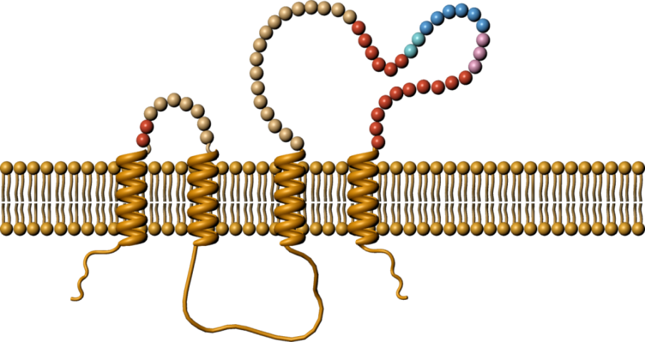
Molecular attributes of ofatumumab
Ofatumumab, first fully human monoclonal antibody being investigated for MS
Ofatumumab is a fully human monoclonal antibody devoid of mouse sequences^{1,2}
Ublituximab binds to a motif that include residues 168–171 and the residues 158–159⁶
Rituximab region involves only the residues of the large (168−175) extracellular loops²⁻⁴
Chimeric
Humanized
Fully human
Ofatumumab binds to a motif that includes residues from the large (145−161) and small (74−80) extracellular loop^{3,4}
-ximab
-zumab
-umab
Ocrelizumab binds to a region (170−178) largely overlapping with that of rituximab⁵
Decreased Immunogenic Potential
Mouse sequence
Human sequence
Figure adapted from: Ruuls SR, et al. Biotechnol J. 2008.
Figure adapted from: Pacheco-Fernandez T, et al.
Presented at EAN2018 [EPR3098].
Figures reproduced with permission of journal

Slide 2
MoA of B-cell depletion
Three mechanisms of B-cell lysis:
ADCC, direct cell death and CDC
Antibody-dependent cellular cytotoxicity
Direct cell lysis
Complement-dependent cytotoxicity
NK cell Monocyte
Anti-CD20 Ab
Anti-CD20 Ab
Anti-CD20 Ab
Complement activation
FcgR
B cell
B cell
B cell
Membrane attack complex → B-cell lysis
Perforin→ B-cell lysis
Depending on the availability of the whole set of complement factors or NK cells/ monocytes, one or the other mechanism prevails at the site of action
Different mechanisms of B cell lysis may explain the differential therapeutic utility of various anti-CD20 antibodies
Figures reproduced with permission of author
1. Pacheco-Fernandez T, et al. Presented at AAN 2018, S52.003. 2. Pacheco-Fernandez T, et al. Neurology 2018; 90 (15 Supplement)

Slide 3
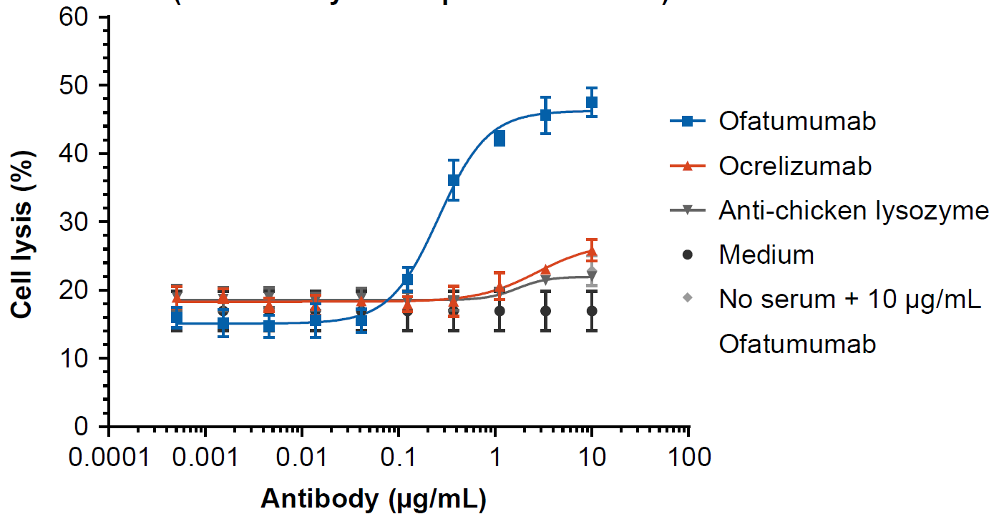
MoA of B-cell depletion
Long-lasting CD20 target engagement by ofatumumab enables efficient lysis of primary human B cells by CDC
CDC with Raji human B cells (8-hour delay of complement addition)
Anti-CD20 Ab
Complement activation
B cell
Membrane attack complex → B-cell lysis
 | Ofatumumab | Ocrelizumab
EC₅₀ (µg/mL) | 0.26 | 2.7
Figures reproduced with permission of author
1. Pacheco-Fernandez T, et al. Presented at AAN 2018, S52.003. 2. Pacheco-Fernandez T, et al. Neurology 2018; 90 (15 Supplement)

Slide 4
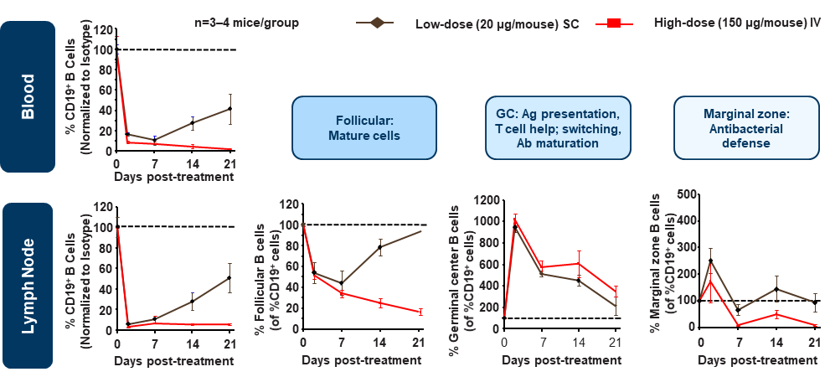
Low-dose SC anti-CD20 therapy relatively spared B-cell subsets
Potent depletion of follicular B-cells with a relative sparing of marginal zone B-cells
Low-dose SC versus high-dose IV therapy demonstrated similar depletion of B cell subsets, including follicular B cells (primary target) but faster B cell recovery after treatment cessation and relatively spared marginal zone B cells (first line of defense against blood-borne infections)

Slide 5
Summary
SC vs IV Route of Administration
Subcutaneous
Intravenous
Following SC injection (⁸⁹Zr-labeled anti-CD20 antibody), preferential distribution to the blood, liver, subiliac lymph nodes and spleen¹
Following IV injection (⁸⁹Zr-labeled anti-CD20 Ab), preferential distribution to the liver and spleen¹
Ofatumumab
SC vs IV
administration
Potent depletion of follicular B-cells with a relative sparing of marginal zone B-cells²
Reduced sparing of marginal zone B cells compared to SC administration²
Decrease in IgM levels and reduced switching to IgG²
Increase in IgM levels but not much change in IgG levels²
Significantly faster repletion in blood, lymph nodes and the spleen after treatment cessation³
Sustained depletion and abnormally low B-cell counts>6 weeks after treatment cessation³

Slide 6
Mirror Study: Study design
Screening phase (<6 weeks)
24-week double-blind treatment phase
Patients with RRMS, aged 18−55 years, history of relapses, or new lesions and EDSS score 0−5.5 (N=232)*
Placebo
Placebo (n=67)
OMB 3 mg q12w
Individual follow-up phase†
Placebo
OMB 3 mg q12w (n=34)
OMB 3 mg q12w
24-week
follow-up phase
(1:1) Placebo or OMB 3 mg
OMB 30 mg q12w (n=32)
OMB 30 mg q12w
(1:1) Placebo or OMB 3 mg
OMB 60 mg q12w (n=34)
OMB 60 mg q12w
(1:1) Placebo or OMB 3 mg
OMB 60 mg q4w (n=64)
OMB 60 mg q4w
Week 0
Week 1
Week 12
Week 24
Week 48
randomization
Primary endpoint
Treatment end
*Of the 232 patients randomized, 231 received ≥1 dose of the study drug and were included in the safety population.
†For patients whose CD19+ B-cell counts remained below the lower limit of normal and who had not started any other DMT.

Slide 7
MIRROR study
Study objective
To assess dose-response effects of the anti-CD20 monoclonal antibody, ofatumumab, administered subcutaneously, on efficacy and safety outcomes in patients with RRMS, and to determine whether dose-dependent B-cell depletion and repletion kinetics could be demonstrated with anti-CD20 antibody therapy
Primary endpoint
Cumulative number of new Gd+ T1 lesions at Week 12 (based on T1-weighted MRI scans at Weeks 4, 8, and 12)

Slide 8
MIRROR study
Cumulative number of new Gd+ T1 lesions
New Gd+ T1 lesions by week in each dose group
Ofatumumab dose:
Ofatumumab dose:
Placebo
Placebo
3 mg q12w
5.0
3 mg q12w
13.0
30 mg q12w
30 mg q12w
12.0
60 mg q12w
4.5
60 mg q12w
11.0
60 mg q4w
4.0
60 mg q4w
10.0
3 mg dose for
patients on placebo
3.5
9.0
8.0
3.0
Mean number of cumulative
T1 Gd+ lesions
Mean number of new
T1 Gd+ lesions
3 mg dose for
patients on placebo
7.0
2.5
6.0
2.0
5.0
1.5
4.0
3.0
1.0
2.0
0.5
1.0
0.0
0.0
Screening
4
8
12
16
20
24
36
48
Baseline
4
8
12
16
20
24
36
48
Time (week)
q12w dose
q12w dose
Time (weeks)
q12w dose
q12w dose
Ofatumumab significantly reduced (65%) the mean rate of cumulative new Gd+ T1 lesions versus placebo at all doses tested between Weeks 0 and 12 (rate ratio: 0.35, 95% CI: 0.221–0.548; p<0.001)
When results were depicted as mean number of new Gd+ lesions counted at the same time points, the effect was evident as early as 4 weeks
Figures reproduced with permission of journal

Slide 9
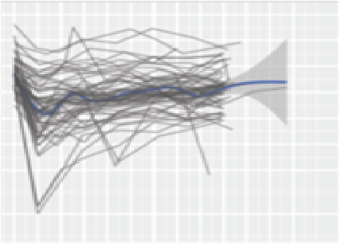
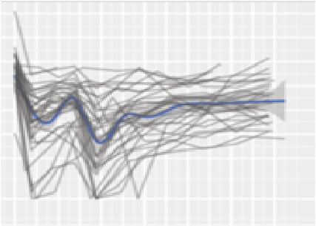
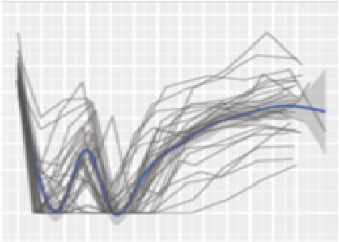
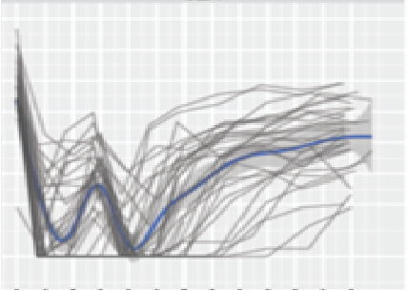
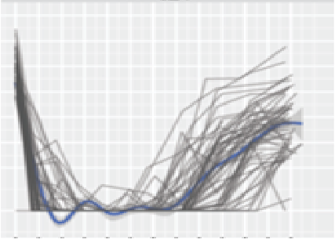
MIRROR study
Change in B-cell counts over time by dosing group
0 mg_3 mg
3 mg_q12w
30 mg_q12w
1024
512
256
128
64
32
16
5
B-cell count (cells/µL)
60 mg_q12w
60 mg_q4w
0
4
8
12
14
20
24
28
32
36
40
44
48
1024
Time (weeks)
512
256
128
64
Note: Low limit of quantification in the MIRROR study: 5 cells/μL. (Figures show individual patient data as gray lines and 95% CI as the gray area)
32
16
5
0
4
8
12
14
20
24
28
32
36
40
44
48
0
4
8
12
14
20
24
28
32
36
40
44
48
Time (weeks)
Time (weeks)
A dose-dependent depletion of B cells was observed, with near to complete B-cell depletion for most of the patients (60 mg treatment group)
Figure reproduced with permission of author

Slide 10
Ofatumumab results in a rapid reduction in B cells, as early as 2 weeks after treatment initiation, with no evidence of reconstitution between doses
Median number of B cells¹
300
500
B-cell depletion over 2 years of treatment²*
Rapid
100
400
B-cell depletion
30
300
10
B-cell counts (cells / μL)
2 cells / μL by
Day 14
CD19+ B-cell counts (cells / µL)
200
3
100
1
Total study population (N = 284)
0.3
0
1
4
7
14
28
42
56
84
Day
0.1
Proportion of patients with B cells <10 cells / μL¹
0
28
56
84
112
140
168
196
224
252
280
308
336
364
392
420
448
476
504
532
560
588
616
644
672
700
728
756
100
Time since first dose, days
80
Sustained
Monthly dosing maintained consistent levels of B-cell depletion with 20 mg dose
Median B-cell depletion to <10 cells / µL was achieved in 8.75 days
Negligible signs of B-cell repletion between doses
B-cell depletion
60
94.0% – 98.1% achieved
<10 cells / μL on Days 28 – 84
Patients with B cells <10 cells / μL (%)
40
20
Total study population (N = 284)
0
More than 94% of patients had <10 cells / µL at B-cell steady state and pre-dose
1
4
7
14
28
42
56
84
Day
LH graphs: Data shown from the APLIOS trial. Arrows, dose administration; grey shading, 5th–95th percentile range of observations (top graph) and 95% confidence interval calculated using the Clopper–Pearson method at each time point marked on the X-axis (lower graph). RH graph: *Simulation is for subcutaneous route with PFS and using Phase III dosage regimen. Simulated median and 90% prediction interval.
LH, left-hand; PFS, prefilled syringe; RH, right-hand.
Wiendl H et al. ePresentation EPR3102 presented at EAN 2020. - Graham G et al. ePoster P0396 presented at ACTRIMS-ECTRIMS 2020.

Slide 11
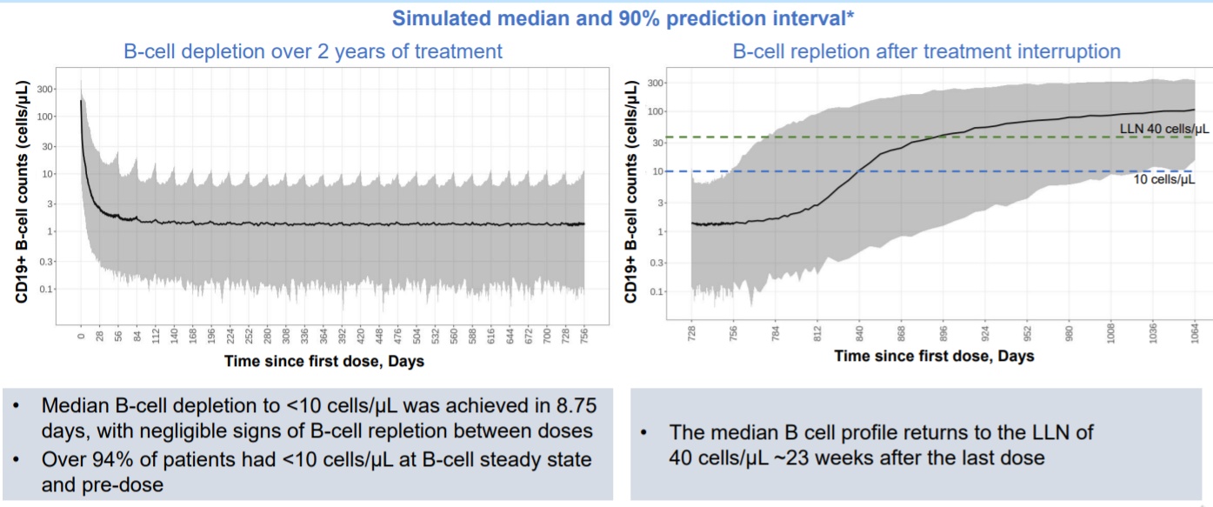
Ofatumumab 20 mg s.c. demonstrated rapid B-cell depletion and repletion after treatment interruption
B cell counts simulated below 0 cells/µL were left censored at 0. *Simulation is for subcutaneous route with PFS and using Phase 3 dosage regimen
LLN. Lower limit of normal; PFS, prefilled syringe; s.c. subcutaneous
Graham G et al. Poster P0396 presented at ACTRIMS- ECTRIMS 2020

Slide 12
MIRROR study
Summary
MRI
Ofatumumab has a high capacity to suppress new brain MRI lesions 12 weeks after treatment initiation
Gd+: 65% reduction at all doses tested between Weeks 0 and 12 (RR: 0.35, 95% CI: 0.221–0.548; p<0.001)
A post hoc analysis showed >90% suppression of new lesions at all cumulative doses ≥30 mg from Weeks 4 and every 12 weeks thereafter
B-cell depletion and repletion
There was no complete depletion of circulating B cells and the treatment effects were robust
Faster repletion with all ofatumumab doses than with other anti-CD20 therapies
Higher dose/higher frequency regimens result in a greater depth of B-cell depletion in the tissues of patients
Safety and tolerability
Subcutaneous ofatumumab had a good safety and tolerability profile
Injection-related reactions were the most common AEs; most were associated with the first dose of ofatumumab and resolved within 1 day of onset
Very low-titer HAHAs were reported in four patients

Slide 13
ASCLEPIOS I and II
Study design
ASCLEPIOS I and II
Double-blind, double-dummy, active comparator-controlled, parallel-group, multicenter adaptive and flexible duration design trials (maximum duration of up to 30 months)
Screening epoch
Treatment epoch
Safety follow-up epoch or
extension study* (ongoing, for up to 5 years)
Screening
Baseline
Teriflunomide 14 mg oral once daily + PBO SC
Population:
>900 RMS patients/study
Age: 18–55 years
EDSS score: 0–5.5
Ofatumumab 20 mg SC (0.4 mL)‡ + PBO oral once daily
D1
D7
D14
W4§
W8
W12
W16
W20
Ofatumumab
Initial dose
60 mg SC (3 × 20 mg)
Ofatumumab
subsequent dose 20 mg SC every 4 weeks
Randomization
EOS (Flexible†)
*Open-label extension study (up to 5 years) via a separate protocol. Patients who complete the treatment epoch while on the study drug may be eligible to participate. The safety FU epoch is included to ensure all patients not entering the extension can have ≥9 months’ FU after the last dose of the study drug.
†The EOS was projected based on a prospectively planned analysis of blinded data to provide 90% power for the primary endpoint, and 90% and 80% power for 3- and 6-month confirmed disability worsening. EOS was defined by the amount of statistical information collected in the trial (relapses and disability events) instead of relying on a fixed time after the last patient has been randomized.
‡20 mg of ofatumumab was administered in an injection volume of 0.4 mL.
§Week 4 (Month 1) and every 4 weeks thereafter.
Figure reproduced with permission of author

Slide 14
ASCLEPIOS I and II
Study objective
To investigate the efficacy and safety of ofatumumab in patients with RMS
Primary endpoint
Secondary endpoints
Annualized relapse rate (number of confirmed MS relapses in a year)
3-month confirmed disability worsening
6-month confirmed disability worsening
6-month confirmed disability improvement

Slide 15
ASCLEPIOS I and II
Ofatumumab SC led to rapid and consistent depletion of B cells in blood
ASCLEPIOS I
ASCLEPIOS II
250
250
Ofatumumab 20 mg
Ofatumumab 20 mg
200
Teriflunomide 14 mg
200
Teriflunomide 14 mg
150
150
B-cell counts (cells/µL)
B-cell counts (cells/µL)
100
100
50
LLN
50
LLN
0
0
Baseline
1
2
4
12
24
36
48
60
72
84
96
108
120
Baseline
1
2
4
12
24
36
48
60
72
84
96
108
120
No. of patients at risk
Time (weeks)
No. patients at risk
Time (weeks)
Ofatumumab
464
439
442
450
443
429
420
404
398
386
263
162
95
28
480
452
457
454
443
436
421
396
389
361
243
155
89
21
Teriflunomide
462
443
437
444
439
419
408
394
382
304
195
121
67
16
474
446
453
449
445
429
404
387
381
300
184
103
28
10
By Week 2, >95% of patients had B-cell concentrations below the LLN, with 82% of patients reaching B-cell depletion of ≤10 cells/µL by Week 2, 92% reaching this level by Week 4, and 98% by Week 12
Figures reproduced with permission of author

Slide 16
ASCLEPIOS I and II
Ofatumumab demonstrated significant reductions in ARR
ASCLEPIOS I
ASCLEPIOS II
50.5%
Relative reduction p<0.001
58.5%
Relative reduction
p<0.001
Adjusted ARR*
Teriflunomide (N’=452)
Ofatumumab (N’=454)
Teriflunomide (N’=469)
Ofatumumab (N’=469)
ARR ratio: 0.495 (95% CI 0.374–0.654)
ARR ratio: 0.415 (95% CI 0.308–0.559)
Figure reproduced with permission of author

Slide 17
ASCLEPIOS I and II
Ofatumumab demonstrated significant reductions in the number of Gd+ T1 lesions
ASCLEPIOS I
ASCLEPIOS II
Number of Gd+ T1 lesions*
97.5%
Relative reduction
p<0.001
93.8%
Relative reduction
p<0.001
Teriflunomide (N’=422)
Ofatumumab (N’=432)
Teriflunomide (N’=434)
Ofatumumab (N’=439)
Rate ratio: 0.025 (95% CI 0.013–0.049)
Rate ratio: 0.062 (95% CI 0.037–0.101)
Figure reproduced with permission of author

Slide 18
ASCLEPIOS I and II
Ofatumumab demonstrated significant reduction in the number of new/enlarging T2 lesions
ASCLEPIOS I
ASCLEPIOS II
82.0%
Relative reduction p<0.001
84.5%
Relative reduction
p<0.001
Number of new/enlarging T2 lesions*
Teriflunomide (N’=431)
Ofatumumab (N’=440)
Teriflunomide (N’=443)
Ofatumumab (N’=448)
Rate ratio: 0.18 (95% CI 0.15–0.22)
Rate ratio 0.15 (95% CI 0.13–0.19)
Figure reproduced with permission of author

Slide 19
ASCLEPIOS I and II
Ofatumumab showed significant reductions in 3-month and 6-month CDW
3-month CDW
6-month CDW
24
20
22
Ofatumumab
18
Ofatumumab
20
Teriflunomide
13.4%
16
Teriflunomide
18
14
10.6%
16
12
14
9.3%
K-M estimate of the cumulative event rate (%)
K-M estimate of the cumulative event rate (%)
7.5%
12
10
10
8
8
Risk reductionª
34.4%
p=0.002*
6
Risk reductionª
32.5%
p=0.012*
6
4
4
2
2
0
0
0
3
6
9
12
15
18
21
24
27
30
33
0
3
6
9
12
15
18
21
24
27
30
33
Number of patients at risk
Study month
Study month
Number of patients at risk
Ofatumumab
944
908
878
844
810
784
534
319
176
49
1
0
944
908
878
845
815
791
544
324
180
50
1
0
Teriflunomide
932
901
841
804
756
718
478
298
146
41
1
0
932
902
849
812
769
734
487
305
151
43
1
0
Hazard ratio: 0.66 (95% CI 0.50–0.86)
Hazard ratio: 0.68 (95% CI 0.50–0.92)
Figures reproduced with permission of author

Slide 20
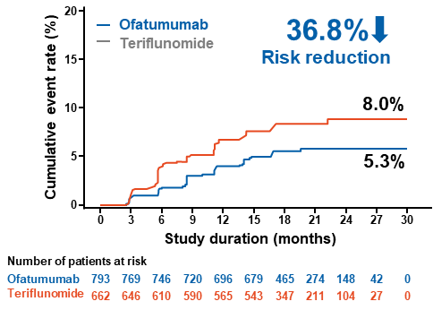
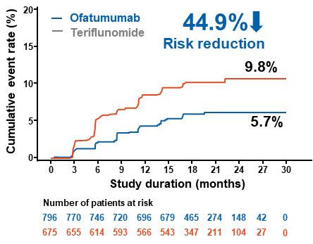
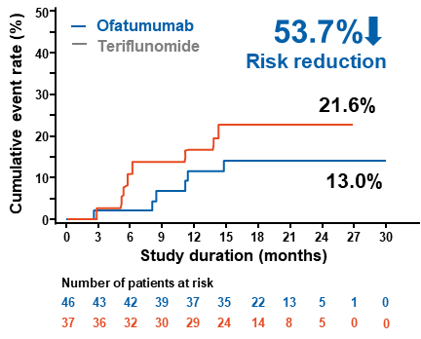
ASCLEPIOS Pooled Analysis
Effect of ofatumumab on time to first 6-month confirmed PIRA event
Patients without confirmed relapses on study
Patients without confirmed relapses on study prior to 6mCDP
SPMS patients without confirmed relapses on study
‒ Teriflunomide
‒ Teriflunomide
‒ Teriflunomide
HR (95% CI): 0.632 (0.421; 0.947)
RR: 36.8%; p=0.026
HR (95% CI): 0.551 (0.377; 0.805)
RR: 44.9%; p=0.002
HR (95% CI): 0.463 (0.158; 1.355)
RR: 53.7%; p=0.160
Ofatumumab delayed the time to first 6mCDP versus teriflunomide in all subsets of RMS patients independent of relapse activity (not significant in subset of SPMS patients without confirmed relapses)
Figures reproduced with permission of author

Slide 21
ASCLEPIOS I and II
Effect of Ofatumumab on NEDA-3 in Years 1, 2 and Years 1-2
OR (95% CI): 3.64 (2.87; 4.61); p<0.001
OR (95% CI): 3.36 (2.67; 4.21); p<0.001
OR (95% CI): 8.09 (6.26; 10.45); p<0.001
Patients with NEDA-3 (%)
N’=854
N’=841
N’=821
N’=833
N’=854
N’=841
N’=821
N’=833
The odds of achieving NEDA-3 with ofatumumab versus teriflunomide was >3-fold higher in the first year and 8-fold higher in the second year of treatment
Figure reproduced with permission of author

Slide 22
ASCLEPIOS I and II
No difference in the slope of brain volume change from baseline between treatments
ASCLEPIOS I
ASCLEPIOS II
0.2
Ofatumumab
Difference in annual rate of brain volume loss*, p=0.12
0.2
Ofatumumab
Difference in annual rate of brain volume loss*, p=0.13
Teriflunomide
Teriflunomide
0.0
0.0
−0.2
−0.2
−0.4
−0.4
Mean PBVC
Mean PBVC
−0.6
−0.6
−0.8
−0.8
−1.0
−1.0
Baseline
12
24
Baseline
12
24
Time (months)
Time (months)
No. patients
Ofatumumab
418
369
86
437
407
74
Teriflunomide
409
352
78
434
399
81
Figure reproduced with permission of author

Slide 23
ASCLEPIOS I and II
Ofatumumab significantly and consistently reduced serum NfL levels
ASCLEPIOS I
ASCLEPIOS II
12
12
11
Ofatumumab
11
Ofatumumab
Teriflunomide
Teriflunomide
10
10
Geometric mean NfL concentration (pg/mL)
Geometric mean NfL concentration (pg/mL)
9
9
8
7%
8
11%
p=0.011
p<0.001
7
27%
7
26%
23%
24%
6
p<0.001
p<0.001
6
p<0.001
p<0.001
0
3
12
24
0
3
12
24
Time (months)
Time (months)
No. of patients
Ofatumumab
465
430
414
371
481
425
406
345
Teriflunomide
462
404
399
350
474
423
406
349
Geometric mean ratio at Month 3: 0.93 (95% CI 0.89–0.98; p=0.011)
Geometric mean ratio at Month 3: 0.89 (95% CI 0.85–0.93; p<0.001)
Figure reproduced with permission of author

Slide 24
AEs were balanced between groups with no unexpected safety findings
Safety events, n (%) | Teriflunomide (N=936) | Ofatumumab (N=946)
Any AEs | 788 (84.2) | 791 (83.6)
Any serious AEs | 74 (7.9) | 86 (9.1)
Most common AEs (≥5% in any treatment group, by preferred term)
Injection-related reaction | 143 (15.3) | 195 (20.6)
Nasopharyngitis | 156 (16.7) | 170 (18.0)
Headache | 116 (12.4) | 126 (13.3)
Injection-site reaction | 52 (5.6) | 103 (10.9)
Upper respiratory tract infection | 120 (12.8) | 97 (10.3)
Urinary tract infection | 78 (8.3) | 97 (10.3)
Back pain | 58 (6.2) | 72 (7.6)
Fatigue | 72 (7.7) | 71 (7.5)
Influenza | 59 (6.3) | 62 (6.6)
Nausea | 64 (6.8) | 61 (6.4)
Blood immunoglobulin M decreased | 21 (2.2) | 56 (5.9)
Alopecia | 138 (14.7) | 54 (5.7)
Arthralgia | 44 (4.7) | 49 (5.2)
Diarrhoea | 111 (11.9) | 49 (5.2)
Pain in extremity | 66 (7.1) | 46 (4.9)
Depression | 48 (5.1) | 45 (4.8)
Hypertension | 55 (5.9) | 35 (3.7)
Paresthesia | 52 (5.6) | 27 (2.9)
Hauser SL, et al. NEJM. 2020;383:546-57; Hauser SL, et al. ECTRIMS 2019. OP336.

Slide 25
Serious AEs were low and overall balanced
Safety events, n (%) | Teriflunomide (N=936) | Ofatumumab (N=946)
Any serious AEs | 74 (7.9) | 86 (9.1)
Most common SAEs (≥1% in any treatment group, by primary system organ class)
Infections and infestations | 17 (1.8) | 24 (2.5)
Injury, poisoning and procedural complications | 9 (1.0) | 13 (1.4)
Benign, malignant and unspecified (including cysts and polyps) neoplasms | 4 (0.4) | 9 (1.0)
Malignancies | 3 (0.3) | 5 (0.5)
Nervous system disorders | 15 (1.6) | 7 (0.7)
Psychiatric disorders | 2 (0.2) | 10 (1.1)
During the ASCLEPIOS I and II studies, one death occurred in the teriflunomide group (fatal aortic haemorrhage)
Hauser SL, et al. NEJM. 2020;383:546-57; Hauser SL, et al. ECTRIMS 2019. OP336.
Notes:
Profilo di eventi avversi basso
Leggermente di più per ofa rispetto a teri

Slide 26
99.8% of reported systemic injection-related reactions with ofatumumab were mild to moderate in severity
The incidence of systemic IRRs was highest at first injection and then decreased significantly therafter^{1,2}
16
Ofatumumab 20 mg
Grade 1
Grade 2
Grade 3
IRR incidences¹
1st injection = 14.4%
2nd injection = 4.4%
3rd injection = <3%
Most frequently reported systemic IRR symptoms (2% or greater) included fever, headache, myalgia, chills and fatigue¹
14
Teriflunomide 14 mg
Grade 1
Grade 2
12
10
Proportion of patients (%)
8
6
4
2
0
1
2
3
4
5
6
7
8
9
10
Number of patients
Injection number
946 936
942 936
937 934
934 929
926 922
914 908
902 898
895 887
889 878
875 860
The imbalance in systemic injection reactions with ofatumumab compared to teriflunomide appears to be limited to the first injection
In ofatumumab group, only one patient (0.1%) with non-serious injection reaction discontinued the study
*In the ofatumumab group, two patients (0.2%) had severe (grade 3) IRRs. One of these patients (0.1%) in the ofatumumab group discontinued after the first injection. IRR, injection-related reaction.
1. Kesimpta® (ofatumumab) [US Prescribing Information]. August 2020. https://www.novartis.us/sites/www.novartis.us/files/kesimpta.pdf. Accessed January 2021. 2. Hauser SL et al. N Engl J Med 2020;383:546–557.
Notes:
IRR sono state soprattutto da lievi a moderate
Le reazioni avverse da infusione di ocre sono state numericamente maggiori e di severità maggiore (grado 3)
Premedication with paracetamolo and/or antihistamines (or equivalent) is recommended and
may be administered at the discretion of the Investigator. For the first injection only, the
addition of premedication with steroids (methylprednisolone 100 mg iv or equivalent) is
recommended. Premedication should be administered 30 to 60 minutes prior to study drug
injection.

Slide 27
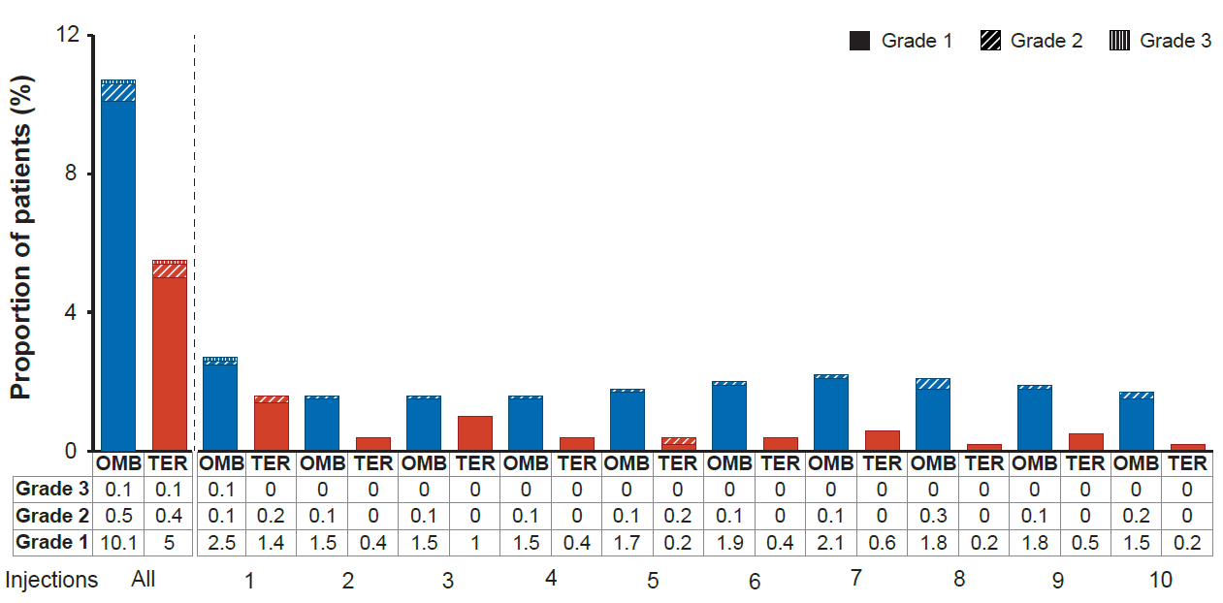
Local site IRRs observed with ofatumumab 20 mg s.c. were mostly mild to moderate in severity and non-serious in nature
Incidence of local IRRs
Incidence of symptoms (≥2% in any group)
Symptoms | Ofatumumab (N=946), % | Teriflunomide (N=936), %
Any symptom | 10.8 | 5.6
Erythema/redness | 5.8 | 1.6
Other, site reaction | 3.7 | 2.2
Pain | 3.1 | 2.0
Itching | 2.6 | 0.4
Induration/ swelling | 2.3 | 0.3

Slide 28
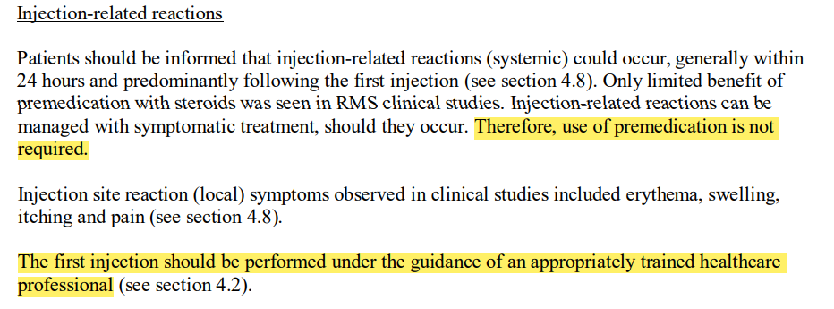
Premedication is not required with ofatumumab

Slide 29
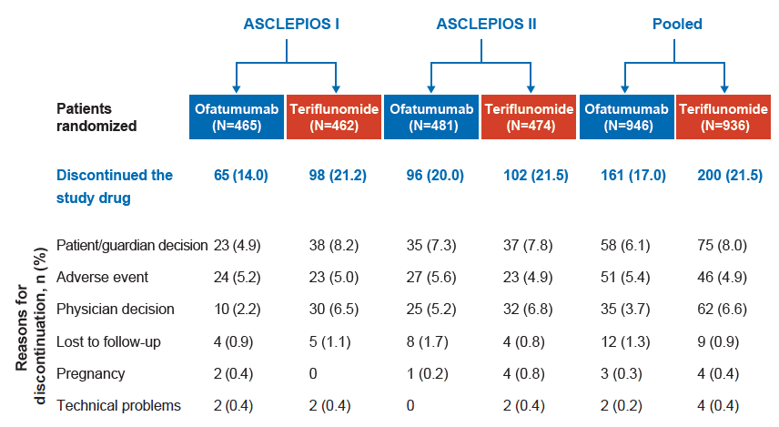
ASCLEPIOS I and II
Compliance to ofatumumab SC in ASCLEPIOS trials
Reasons for discontinuation from the study drug
The most common reasons for discontinuation (>2% in any group) were patient/guardian decision, adverse event, and physician decision

Slide 30
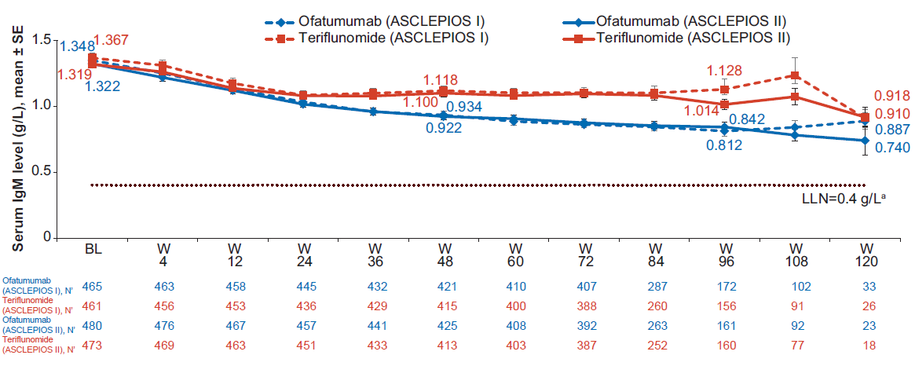
ASCLEPIOS I and II
Change in serum IgM levels from baseline over time
Figure reproduced with permission of author
Reduction in serum IgM levels was observed over time in both treatment groups in both studies, the levels remained well within the reference ranges

Slide 31
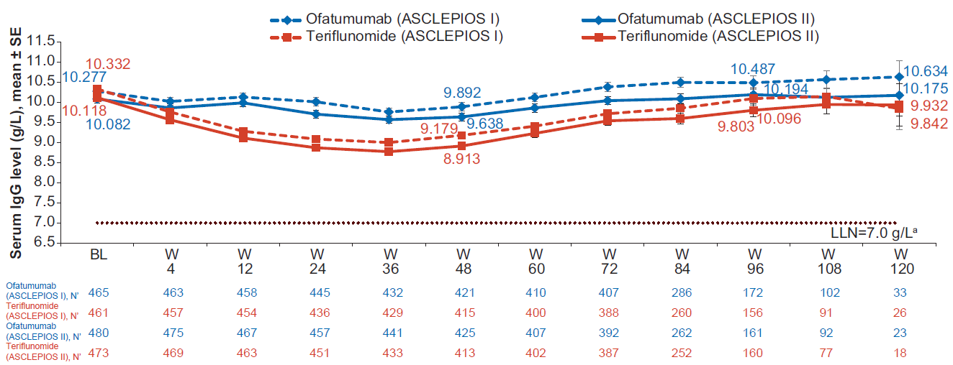
ASCLEPIOS I and II
Change in serum IgG levels from baseline over time
Average serum IgG levels remained well within the reference ranges over time; no decrease was observed in mean IgG levels compared to baseline
Figure reproduced with permission of author

Slide 32
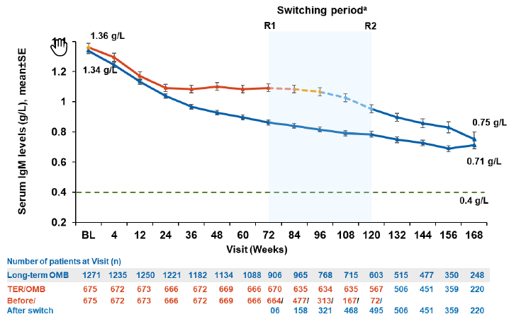
Average IgM levels remained well within the references ranges over time
Heinz Wiendl et al. Presented at ECTRIMS 2021. P931

Slide 33
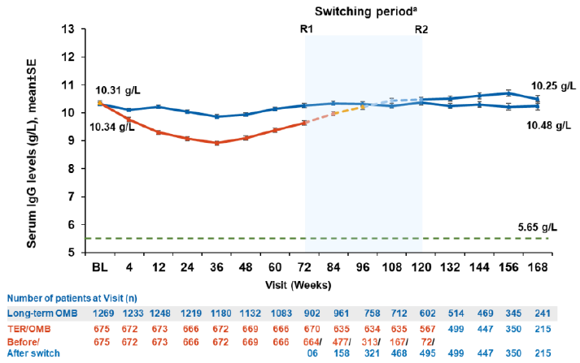
The mean serum IgG remained stable with up to 3.5 years of ofatumumab treatment
Heinz Wiendl et al. Presented at ECTRIMS 2021. P931

Slide 34
The overall incidence of serious infections was low over 3.5 years
Heinz Wiendl et al. Presented at ECTRIMS 2021. P931

Slide 35
ASCLEPIOS I and II
Summary
The ASCLEPIOS I and II studies in a broad RMS population successfully demonstrated that ofatumumab (vs teriflunomide) had:
Superior efficacy in lowering relapse rates and MRI activity
Lower levels of NfL as early as Month 3 and at all subsequent visits
A favourable safety profile with no unexpected safety signals, and no imbalance in the rates of infections or malignancies (low on both arms)
Substantial and significant reductions in 3- and 6-month CDW
Ofatumumab with a monthly 20 mg SC* dosing regimen, demonstrated high efficacy and a favourable safety profile

